Slide 1

19CS2211 - Software Engineering
Software Testing
Session – 20

Slide 2

Black-box Testing
Also called behavioral testing
Focuses - functional requirements of software.
Enable sets of input conditions - fully exercise all functional requirements for a program.
Black-box testing is not an alternative to white-box techniques.
To uncover a different class of errors.

Slide 3
Tests are designed to answer the following questions:
How is functional validity tested?
How are system behavior and performance tested?
What classes of input will make good test cases?
Is the system particularly sensitive to certain input values?
How are the boundaries of a data class isolated?
What data rates and data volume can the system tolerate?
What effect will specific combinations of data have on system operation?

Slide 4
By applying black-box techniques, you derive a set of test cases that satisfy the following criteria:
test cases that reduce, by a count that is greater than one, the number of additional test cases that must be designed to achieve reasonable testing, and
test cases that tell you something about the presence or absence of classes of errors, rather than an error associated only with the specific test at hand.

Slide 5
Graph-Based Testing Methods
Understand the objects in software
Connect these objects using relationships.
Define a series of tests - all objects have the expected relationship to one another.
A number of behavioral testing methods that can make use of graphs:
Transaction flow modeling.
Finite state modeling.
Data flow modeling.
Timing modeling.

Slide 6
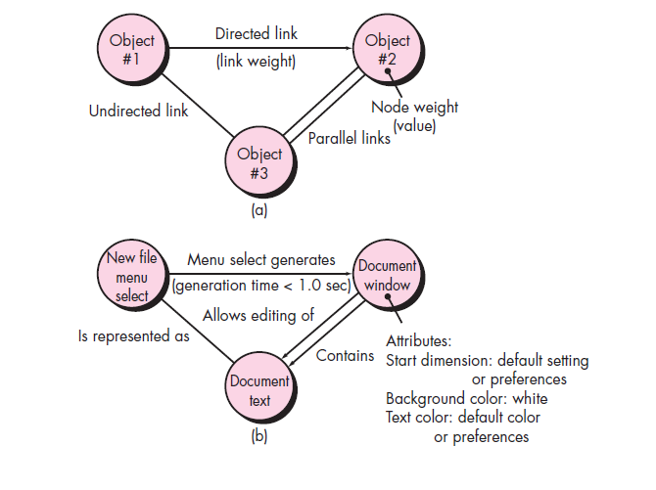
(a) Graph notation (b) simple example

Slide 7
Equivalence Partitioning
It is a black-box testing method.
Divides the input domain into classes of data
from these data - test cases can be derived.
Test-case design - based on an evaluation of equivalence classes for an input condition.

Slide 8
Equivalence classes may be defined according to the following guidelines:
1. If an input condition specifies a range, one valid and two invalid equivalence classes are defined.
2. If an input condition requires a specific value, one valid and two invalid equivalence classes are defined.
3. If an input condition specifies a member of a set, one valid and one invalid equivalence class are defined.
4. If an input condition is Boolean, one valid and one invalid class are defined.

Slide 9
Boundary Value Analysis (BVA)
More errors occurs at the boundaries in input
Lesser errors in “center” in input
For this reason that boundary value analysis (BVA) has been developed as a testing technique.
BVA leads to a selection of test cases that exercise bounding values.

Slide 10
Guidelines for BVA are similar in many respects to those provided for equivalence partitioning:
If an input condition specifies a range bounded by values a and b, test cases should be designed with values a and b and just above and just below a and b.
If an input condition specifies a number of values, test cases should be developed that exercise the minimum and maximum numbers. Values just above and below minimum and maximum are also tested.

Slide 11
Apply guidelines 1 and 2 to output conditions. Test cases should be designed to create an output report that produces the maximum (and minimum) allowable number of table entries.
If internal program data structures have prescribed boundaries (e.g., a table has a defined limit of 100 entries), be certain to design a test case to exercise the data structure at its boundary.

Slide 12
Orthogonal Array Testing
Applied to problems in which the input domain is relatively small but too large to accommodate exhaustive testing.
Useful in finding region faults - faulty logic within a software component.

Slide 13
Black-box Testing
To find errors in the following categories:
incorrect or missing functions
interface errors
errors in data structures or external database access
behavior or performance errors
initialization and termination errors

Slide 14
White-box Testing
Called glass-box testing
Used in control structure
guarantee that all independent paths within a module have been exercised at least once
exercise all logical decisions on their true and false sides
execute all loops at their boundaries and within their operational bounds
exercise internal data structures to ensure their validity

Slide 15
Validation Testing
It begins at the culmination of integration testing
when individual components have been exercised, the software is completely assembled as a package, and interfacing errors have been uncovered and corrected.
At the validation or system level, the distinction between conventional software, object-oriented software, and WebApps disappears.
Testing focuses on user-visible actions and user-recognizable output from the system.

Slide 16
Validation Criteria:
After each validation test case has been conducted, one of two possible conditions exists:
The function or performance characteristic conforms to specification and is accepted or
a deviation from specification is uncovered and a deficiency list is created.
Note:
Deviations or errors discovered at this stage in a project can rarely be corrected prior to scheduled delivery.

Slide 17
Configuration Review:
To ensure that all elements of the software configuration have been properly developed, are cataloged, and have the necessary detail to bolster the support activities.

Slide 18
Alpha and Beta Testing
The alpha test:
Conducted at the developer’s site
Developer should present
Used in a natural setting with the developer “looking over the shoulder” of the users and recording errors and usage problems.
The beta test:
Conducted at one or more end-user sites.
Developer generally is not present.
Therefore, the beta test is a “live” application of the software in an environment that cannot be controlled by the developer.

Slide 19
A variation on beta testing, called customer acceptance testing:
Performed when software is delivered to a customer under contract.
The customer performs a series of specific tests in an attempt to uncover errors before accepting the software from the developer.

Slide 20
System Testing
series of different tests whose primary purpose is to fully exercise the computer-based system.
Purpose - to verify that system elements have been properly integrated and perform allocated functions.

Slide 21
Recovery Testing:
It is a system test
It forces the software to fail in a variety of ways and verifies that recovery is properly performed.
If recovery is automatic (performed by the system itself), re-initialization, check pointing mechanisms, data recovery, and restart are evaluated for correctness.
Security Testing:
Protect the system from improper penetration.

Slide 22
Stress Testing:
Executes a system – with resources in abnormal quantity, frequency, or volume.
A variation of stress testing is a technique called sensitivity testing.
Sensitivity testing - to uncover data combinations within valid input classes that may cause instability or improper processing.

Slide 23
Performance Testing:
To test the run-time performance of software within the context of an integrated system.
Performance testing occurs throughout all steps in the testing process. Performance tests are often coupled with stress testing
It require both hardware and software instrumentation.

Slide 24
Deployment Testing:
Called configuration testing
Exercises the software in each environment in which it is to operate
Examines all installation procedures and specialized installation software (e.g., “installers”) that will be used by customers
All documentation that will be used to introduce the software to end users

Slide 25
Revision Questions
Define System Testing.
2. Outline the types of System testing.
Explain behavioral testing that make use of graphs.
Distinguish White Box and Black Box Testing.
Distinguish Validation Testing and Black Box Testing.
Distinguish Performance Testing and Deployment Testing.

Slide 26
Thank You

